Slide 1
Audit of Corporate Governance
CECGA Seminar
October 2015

Slide 2
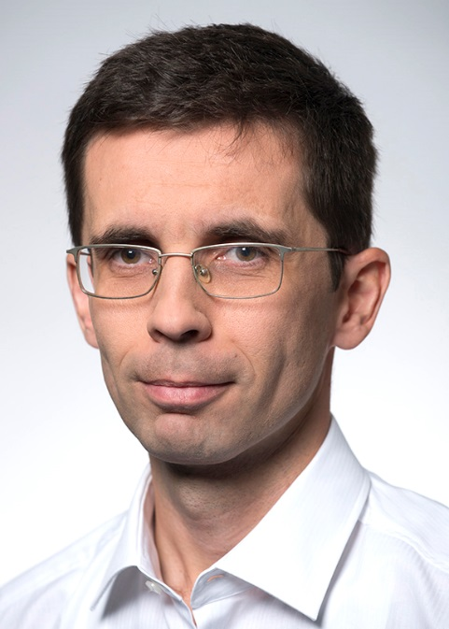
Introduction ...
Viliam Kačeriak, CIA, CFE
Head of Governance, Risk and Compliance
KPMG Slovakia
vkaceriak@kpmg.sk
Notes:
Introduce presenter ...

Slide 3
Agenda
Setting up the context ...
Why an audit of CG?
Types of CG audit
IA focus areas
Key findings
Specifics of CG in Slovakia
Trends in CG
Discussion
Notes:
Today’s agenda: a brief overview of CG auditing including ....

Slide 4
Setting up the context CG definition
Corporate governance involves a set of relationships between a company’s management, its board, its shareholders and other stakeholders.
Corporate governance also provides the structure through which the objectives of the company are set, and the means of attaining those objectives and monitoring performance are determined.
OECD Principles of Corporate Governance
Notes:
CG je teda suhrn vztahov medzi stakeholdermi za ucelom dosiahnutia cielov.
Corporate Governance možno definovať aj ako kombináciu procesov a štruktúr implementovaných predstavenstvom/dozornou radou za účelom dosiahnuť stanovené ciele a naplniť očakávania akcionárov.

Slide 5
Setting up the context Stimulus for Corporate Governance
Examples of collapses and scandals that shaped CG rules:
Vereinigte
Ostindische
Compagnie
Bank of Credit Commerce
International
Lucent
Technologies
WorldCom
Société
Generale
1799
1990
1991
1995
2000
2001
2002
2003
2007
2008→
Mirror Group
Barings Bank
Enron
Parmalat
Lehman Brothers
Goldman Sachs
Morgan Stanley
Merill Lynch
London Scotisch Bank
Landsbanki Iceland
Turnbull report (UK)
The OECD Corporate Governance Code
Smith & Higgs report (UK)
World Bank review of GC in Slovakia
8th Company Law
Directive (EU)
EBA Guidelines on Internal Governance
Greenbury report (UK)
1995
1799
1992
1998
1999
2001
2002
2003
2004
2005
2010
2011
Cadbury
report (UK)
Hampel
report (UK)
Sarbanes-Oxley
Act (“SOX”)
Slovak Code (SK)
EBA Guidelines on remuneration
New EC legislation

Slide 6
Why audit of CG
IPO
New legislation
Assurance for shareholders/investors
Assurance for management
Regulatory requirement
Strategic goal to improve CG performance

Slide 7
Why audit of CG What investors want to know?
Do you have a strategic plan?
Have you defined the short-term and the long-term financial success?
What is the R&D structure?
What is the greatest Threat to the business?
Is the board sure it has all the Relevant Information?
Are the company and board in compliance with ethical behavior?
Do you have effective system of performance evaluation
Notes:
Source: Risk Management Disclosure - An Institutional Investors Perspective. Hermes Pension Management Limited

Slide 8
Types of CG audit
Highly performing program
Performance audit
Assurance audit
Design Effectiveness
Operational Effectiveness
Effective program
Notes:
Compliance/effectiveness type audit – assurance (design and control performance) – focus on minimum requirements – gap analysis
Performance audit – consulting (i.e. overall performance and effectiveness and efficiency) – Focus on business value and optimisation. Deals more with the “speed/why” rather then “right direction/how”. Focus on outcomes/goals, and allows prioritization, allocation, motivation. Ongoing or periodic.

Slide 9
Types of CG audit Assurance audit of CG - process
Define audit objective and Define authoritative model
Consider governance risks
Plan engagement approach/program and
Perform audit and communicate results
Monitor improvement
Source: IIA Practice guide on auditing organizational governance

Slide 10
7 principles of soft governance
Select the right people.
Train, train, train.
Inform and communicate.
Balance the CEO’s power.
Establish new behaviors.
Devote the time.
Evaluate and improve.

Slide 11
Types of CG audit Performance audit - process
Identify and review business objectives.
Identify program objectives that are aligned with enterprise objectives.
Define indicators and targets to measure performance.
Measure indicators.
Analyze indicators.
Improve and control program processes to drive indicators toward targets.
Identify and review business objectives.

Slide 12
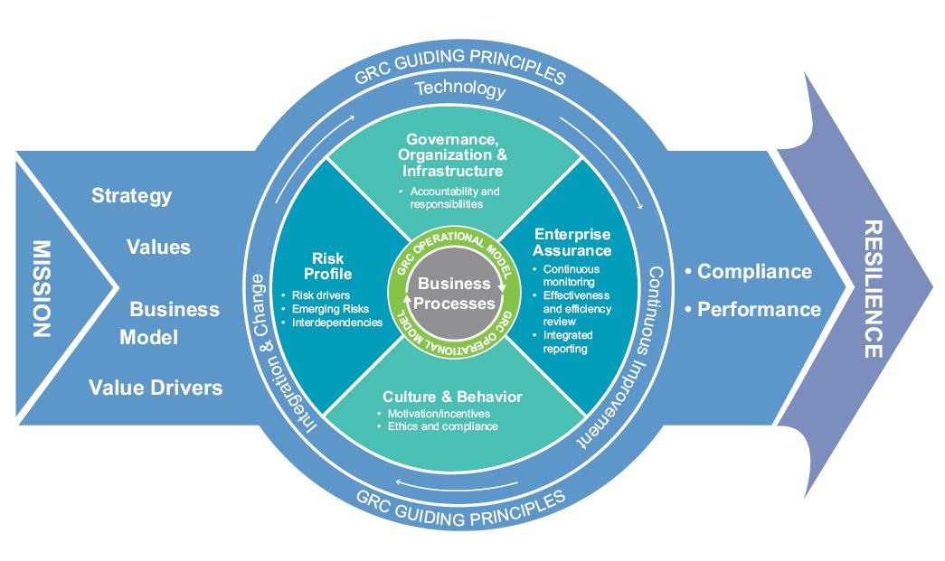
KPMG GRC Model

Slide 13
IA focus areas
Consideration of best practices and adaptation to the specific organization – focus on optimization of governance practices and structure
Allocation of Audit
Perform audits of design and effectiveness of specific governance related processes
Provide advice with focus on governance structure to meet compliance requirements and basic risks of organization
Less Structured
More Structured

Slide 14
IA focus areas Principles of Corporate Governance (EBA)
14. Odmeňovanie zamestnancov
8. Zodpovednosť vedenia
7. Manažment
rizika
1. Interná komun.
13. Transparentnosť
6. Interné
kontroly
9. Použitie inej práce
2. Kvalifikácia
Princípy CG
5. Riadenie
manažmentom
3. Riadiace
postupy
12. Pochopenie
štruktúry
4. CG
skupiny
10. Štruktúry špeciálneho zámeru
11. Dohľad dozornej
rady
Source: EBA Principles for enhancing CG
Notes:
Pr 1 Effective risk management requires robust internal communication within the bank about risk, both across the organisation and through reporting to the board and senior management.
Pr 2 Board members should be and remain qualified, including through training, for their positions. They should have a clear understanding of their role in corporate governance and be able to exercise sound and objective judgment about the affairs of the bank.
Pr 3 The board should define appropriate governance practices for its own work and have in place the means to ensure that such practices are followed and periodically reviewed for ongoing improvement.
Pr 4 In a group structure, the board of the parent company has the overall responsibility for adequate corporate governance across the group and ensuring that there are governance policies and mechanisms appropriate to the structure, business and risks of the group and its entities.
Pr 5 Under the direction of the board, senior management should ensure that the bank’s activities are consistent with the business strategy, risk tolerance/appetite and policies approved by the board.
Pr 6 Banks should have an effective internal controls system and a risk management function (including a chief risk officer or equivalent) with sufficient authority, stature, independence, resources and access to the board.
Pr 7 Risks should be identified and monitored on an ongoing firm-wide and individual entity basis, and the sophistication of the bank’s risk management and internal control infrastructures should keep pace with any changes to the bank’s risk profile (including its growth), and to the external risk landscape.
Pr 8 The board has overall responsibility for the bank, including approving and overseeing the implementation of the bank’s strategic objectives, risk strategy, corporate governance and corporate values. The board is also responsible for providing oversight of senior management.
Pr 9 The board and senior management should effectively utilise the work conducted by internal audit functions, external auditors and internal control functions.
Pr 10 Where a bank operates through special-purpose or related structures or in jurisdictions that impede transparency or do not meet international banking standards, its board and senior management should understand the purpose, structure and unique risks of these operations. They should also seek to mitigate the risks identified (ie “understand-your-structure”).
Pr 11 The board should actively oversee the compensation system’s design and operation, and should monitor and review the compensation system to ensure that it operates as intended.
Pr 12 The board and senior management should know and understand the bank’s operational structure and the risks that it poses (ie “know-your-structure”).
Pr 13 The governance of the bank should be adequately transparent to its shareholders, depositors, other relevant stakeholders and market participants.
Pr 14 An employee’s compensation should be effectively aligned with prudent risk taking: compensation should be adjusted for all types of risk; compensation outcomes should be symmetric with risk outcomes; compensation payout schedules should be sensitive to the time horizon of risks; and the mix of cash, equity and other forms of compensation should be consistent with risk alignment.

Slide 15
Key audit observations
Minimum effort
People management
Conflict of interest and independence
Reporting
Audit and verification
Non-compliance reporting not done
Insufficient risk management

Slide 16
Specifics of CG in Slovakia
Corporate secretary not obligatory
Frequent board meetings
SB composed of independent members
IA is recommended not obligatory for listed companies
No specific framework obligatory for internal controls (e.g. COSO)
Revision commission is not obligatory
NBS not among the most respected institutions (RTVS and army)

Slide 17
Did you know?
100 mil. €
refused VAT refunds in Slovakia per year.
3 mil. €
of total fines per year by the 3 authorities below.
30 000
inspected entities a year in Slovakia by inspection bodies for Personal Data, Labour and Environment.
2
amendments/ year – each act is amended by two regulations a year in average.
30 %
of CFO said their priority is to improve regulatory compliance capabilities.
40 %
of self-reported data is incorrect.

Slide 18
Trendy v CG
Strategy: Focus on long-term
objectives and sustainability
Executive compensation and
say on pay
Composition: Board composition
and diversity and succession
Transparency and ethics
Use of technologies and
IT governance
Key trends
Notes:
New G20/OECD CG principles: “the increasing complexity of the investment chain, the changing role of stock exchanges and the emergence of new investors, investment strategies and trading practices.”
“recommendations for improvements in priority areas such as remuneration, risk management, board practices and the exercise of shareholder rights.”
The most significant change is the addition of chapter III on the governance of “Institutional Investors, Stock Markets, and Other Intermediaries”.
Ad 3) Greater emphasis is also put on the transparency and governance of private exchanges, other trading venues (such as “dark pools”) and new forms of trading practices such as high frequency trading and the use of derivatives (Ch. I & III).
The revised text also has the merit of recognising the role of board level employee representatives by integrating existing text from the 2005 OECD Guidelines for the corporate governance of state-owned enterprises.
Stratégia
Krízu vyvolal “shor-terminism” – tlak na rýchly výnos, v súčanosti sa dôrazňuje udržateľnosť rozvoja firmy a dlhodobé ciele
Odklonenie sa od “director-centric model” smerom k “shareholder-centric model of corporate governance” – všetko, čo dáva väčšiu moc do rúk akcionárov, je dobré.
Zloženie správnych orgánov
Zvýšený dôraz na “kvalitu” členov správnych orgánov – úvahy o správnom zložení čo do kvalifikácie, veku, skúseností
Úvahy o diverzifikácii členov správnych orgánov - aké má byť zastúpenie žien a minoritných skupín
Prebiehajúce úvahy, ktorý model je správny, príklon k európskemu modelu.
Zriadenie výboru pre riadenie rizika
Transparentnosť a etika
Zverejňovanie informácii o príspevkoch na politickú kampaň
Zdôrazňovanie úlohy predstavenstva pri definovaní kultúry a etiky v organizácii
Zverejňovanie informácií o osobách s osobitným vzťahom
Nulová tolerancia k podvodom / korupcii + whistleblowing (UK ABC -Nižšia penalizácia v prípade efektívneho compliance programu.)
Odmeňovanie
Zverejňovanie informácií o naviazaní odmien na finančné výsledky (pay for performance).
Akcionári schvaľujú ohodnotenie členov vedenia (say-on-pay).
Nezávislosť výboru pre odmeňovanie
Kontrola zlatých padákov a rozhodovanie na úrovni výboru pre odmeňovanie a akcionárov
Obmedzenie nadmerne motivačného odmeňovania
Disclosure and transparency
Disclosure of information, transparency of publicly traded companies as well as requirements on audit are being very carefully monitored.
The current issues related to the disclosure and transparency are:
Liquidity, cash flow quality and specific risks and impact of the financial crisis.
Internal controls due to of increased risk of committing internal fraud during the crisis.
Sustainability
Technologies
- Voting technologies, ongoing monitoring dashboards for board members, dedicated websites for shareholders and investors

Slide 19
FAQ
Why audit of CG?
How often CG shall be audited and what scope?
What are typical findings?
Is compliance with CG regulations guarantee of organization’s success?
What are the key CG risks?
Would you like to have CG audited? Which areas?
Do you believe Slovak companies are well governed? What shall be improved?
Does your IA audit CG?
What are key differences comparing to foreign firms?
Notes:
Otazky do diskusie:
Ktora zlozka governance zlyhala v pripade kauzy VW? (zlyhali zakony? Chybal eticky kodex a definovane hodnoty? Chybali dostatocne interne smernice? Zlyhala komunikacia hodnot na urovni boardu a akcionarov.)
Co myslite, co by bol prvy krok pri merani performance CG? (pochopit ciele organizacie)
Robite si personalne audity svojich zodpovednosti?

Slide 20
Thank you
Viliam Kačeriak
vkaceriak@kpmg.sk
The information contained herein is of a general nature and is not intended to address the circumstances of any particular individual or entity. Although we endeavor to provide accurate and timely information, there can be no guarantee that such information is accurate as of the date it is received or that it will continue to be accurate in the future. No one should act on such information without appropriate professional advice after a thorough examination of the particular situation.
© 2015, KPMG Slovensko, spol. s r.o., a Slovak limited liability company and a member firm of the KPMG network of independent member firms affiliated with KPMG International Cooperative, a Swiss entity. All rights reserved.
The KPMG name, logo and “cutting through complexity” are registered trademarks or trademarks of KPMG International.

